Slide 1
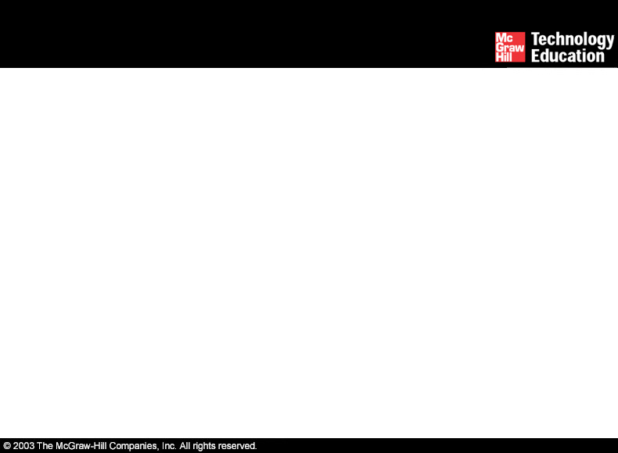
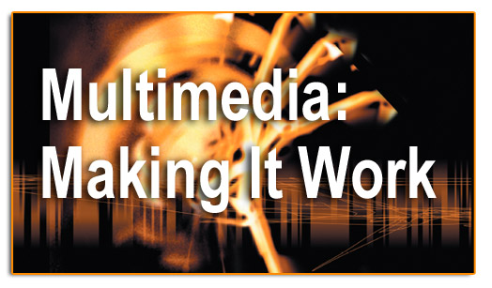
Lesson 1-What is Multimedia?
Class Discussion: What do you think multimedia is? Examples? Definition?

Slide 2
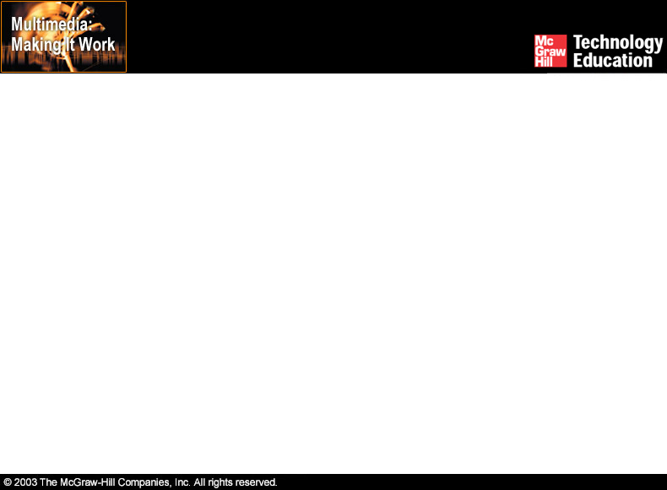
Overview
Topics for this lecture
Introduction to multimedia.
Applications of multimedia.
Virtual reality (VR).

Slide 3
Introduction to Multimedia
Multimedia is a combination of text, art, sound, animation, and video.
It is delivered to the user by electronic or digitally manipulated means.
A multimedia project development requires creative, technical, organizational, and business skills.

Slide 4
Introduction to Multimedia
Multimedia becomes interactive multimedia when a user is given the option of controlling the elements.
What does it mean to say something is interactive?
Interactive multimedia is called hypermedia when a user is provided a structure of linked elements for navigation.
What are some common examples of hypermedia ?
Multimedia developers develop multimedia projects.

Slide 5
Introduction to Multimedia
The software vehicle, the messages, and the content together constitute a multimedia project.
What do you think is meant by the software vehicle, the message, the content ?
A multimedia project shipped to end-users with or without instructions is called a multimedia title.
A project can also be launched on the Web.
Name two types of delivery for MM projects

Slide 6
Introduction to Multimedia
Multimedia projects can be linear or nonlinear.
Projects that are not interactive are called linear.
Projects where users are given navigational control are called non-linear and user-interactive.
Definition of linear and non-linear
Give some examples of a linear mm product
Give some examples of a non-linear mm product

Slide 7
Introduction to Multimedia
Authoring tools are used to merge multimedia elements into a project.
Director is an example of a Multimedia Authoring tool.
Can use many different types of digital media files from many different sources
These software tools are designed to manage individual multimedia elements and provide user interaction.
What do you think are the advantages of using this type of MM tool?

Slide 8
Introduction to Multimedia
The primary media for delivering multimedia projects are:
  Compact disc read-only (CD-ROM).
  Digital Versatile Disc (DVD).
  Why use CD-ROM or DVD to deliver an MM project?
  What other options exist?

Slide 9
Compact Disc Read-Only
(CD-ROM)
CD-ROM is the most cost-effective distribution medium for multimedia projects.
It can contain up to 80 minutes of full-screen video or sound.( on a 700MB CD)
CD burners are used for reading discs and converting the discs to audio, video, and data formats.

Slide 10
Digital Versatile Disc (DVD)
Multilayered DVD technology increases the capacity of current optical technology to 18 GB.
Single side single layer 4.7GB
DVD authoring and integration software is used to create interactive front-end menus for films and games.
DVD burners are used for reading discs and converting the disc to audio, video, and data formats.

Slide 11
Introduction to Multimedia
Copper wire, glass fiber, and radio/cellular technologies also serve a means for delivering multimedia files across a network.
What significant developments in network delivery systems have made it easier to deliver MM over the web?
What applications are MM titles commonly developed for?
-Brainstorm a list

Slide 12
Applications of Multimedia
Business - Business applications for multimedia include presentations training, marketing, advertising, product demos, databases, catalogues, instant messaging, and networked communication.
Schools - Educational software can be developed to enrich the learning process.

Slide 13
Applications of Multimedia
Home - Most multimedia projects reach the homes via television sets or monitors with built-in user inputs.
Public places - Multimedia will become available at stand-alone terminals or kiosks to provide information and help.

Slide 14
Virtual Reality (VR)
Virtual reality is an extension of multimedia.
It uses the basic multimedia elements of imagery, sound, and animation.
It requires terrific computing horsepower to be realistic.

Slide 15
Virtual Reality (VR)
In VR, cyberspace is made up of thousands of geometric objects plotted in three-dimensional space.
The standards for transmitting VR in Virtual Reality Modeling Language (VRML) documents have been developed on the World Wide Web.
VRML documents have the file extension .wrl.

Slide 16
Summary
Multimedia is a combination of text, graphic art, sound, animation, and video.
Multimedia projects can be linear or nonlinear.
Multimedia projects are often stored on CD-ROM or DVDs. They can also be hosted on the Web.

Slide 17
Summary
Multimedia is widely used in business, schools, public places, and at home.
Virtual reality is an extension of multimedia.

